Slide 1
Transforming steering controls to self driving
Week 2 report
Hongshuo Wang
Professor Siu Ling Leung

Slide 2
Topics
Matlab Deep learning Certification
Basic idea of NN
Pre-trained Network
CNN
the essential building and their common sign in mini town

Slide 3
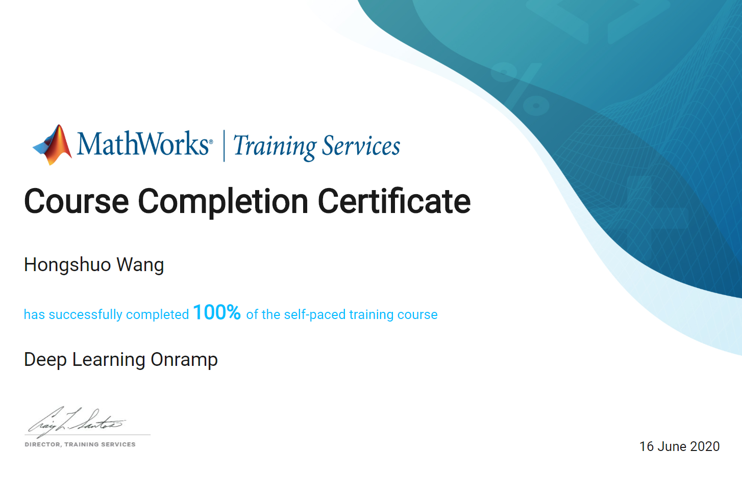
Certification

Slide 4
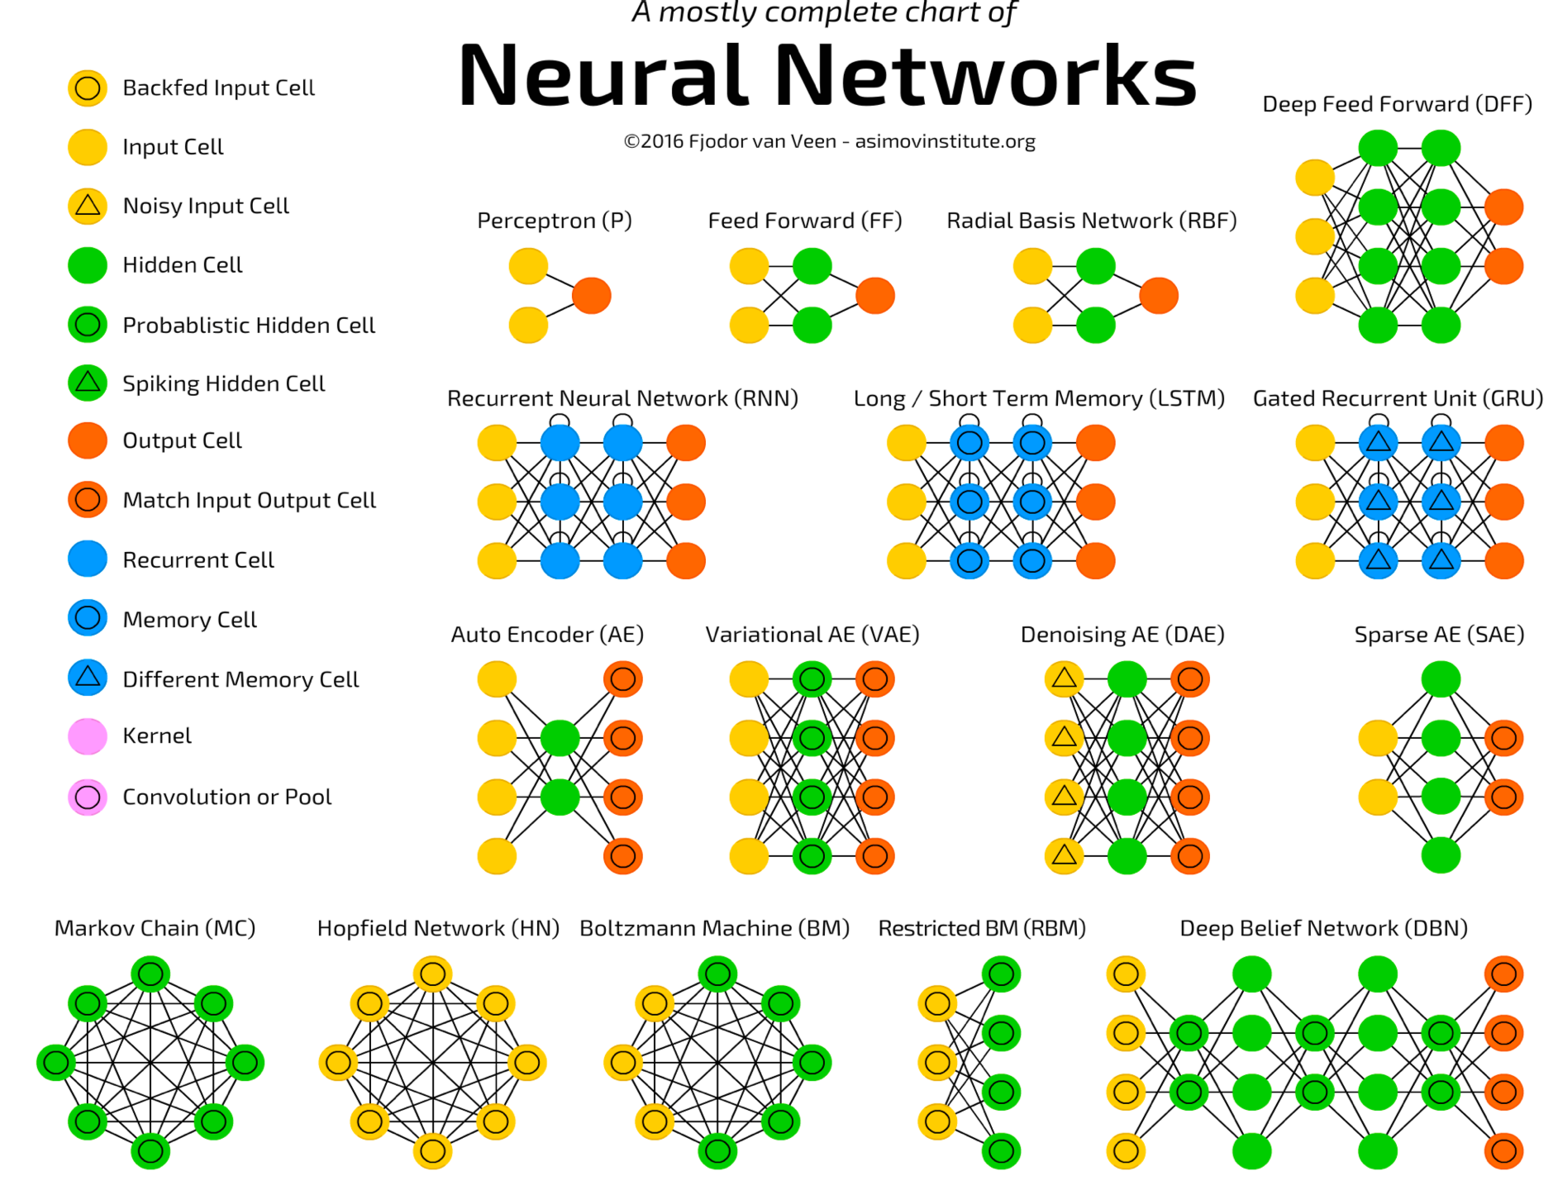
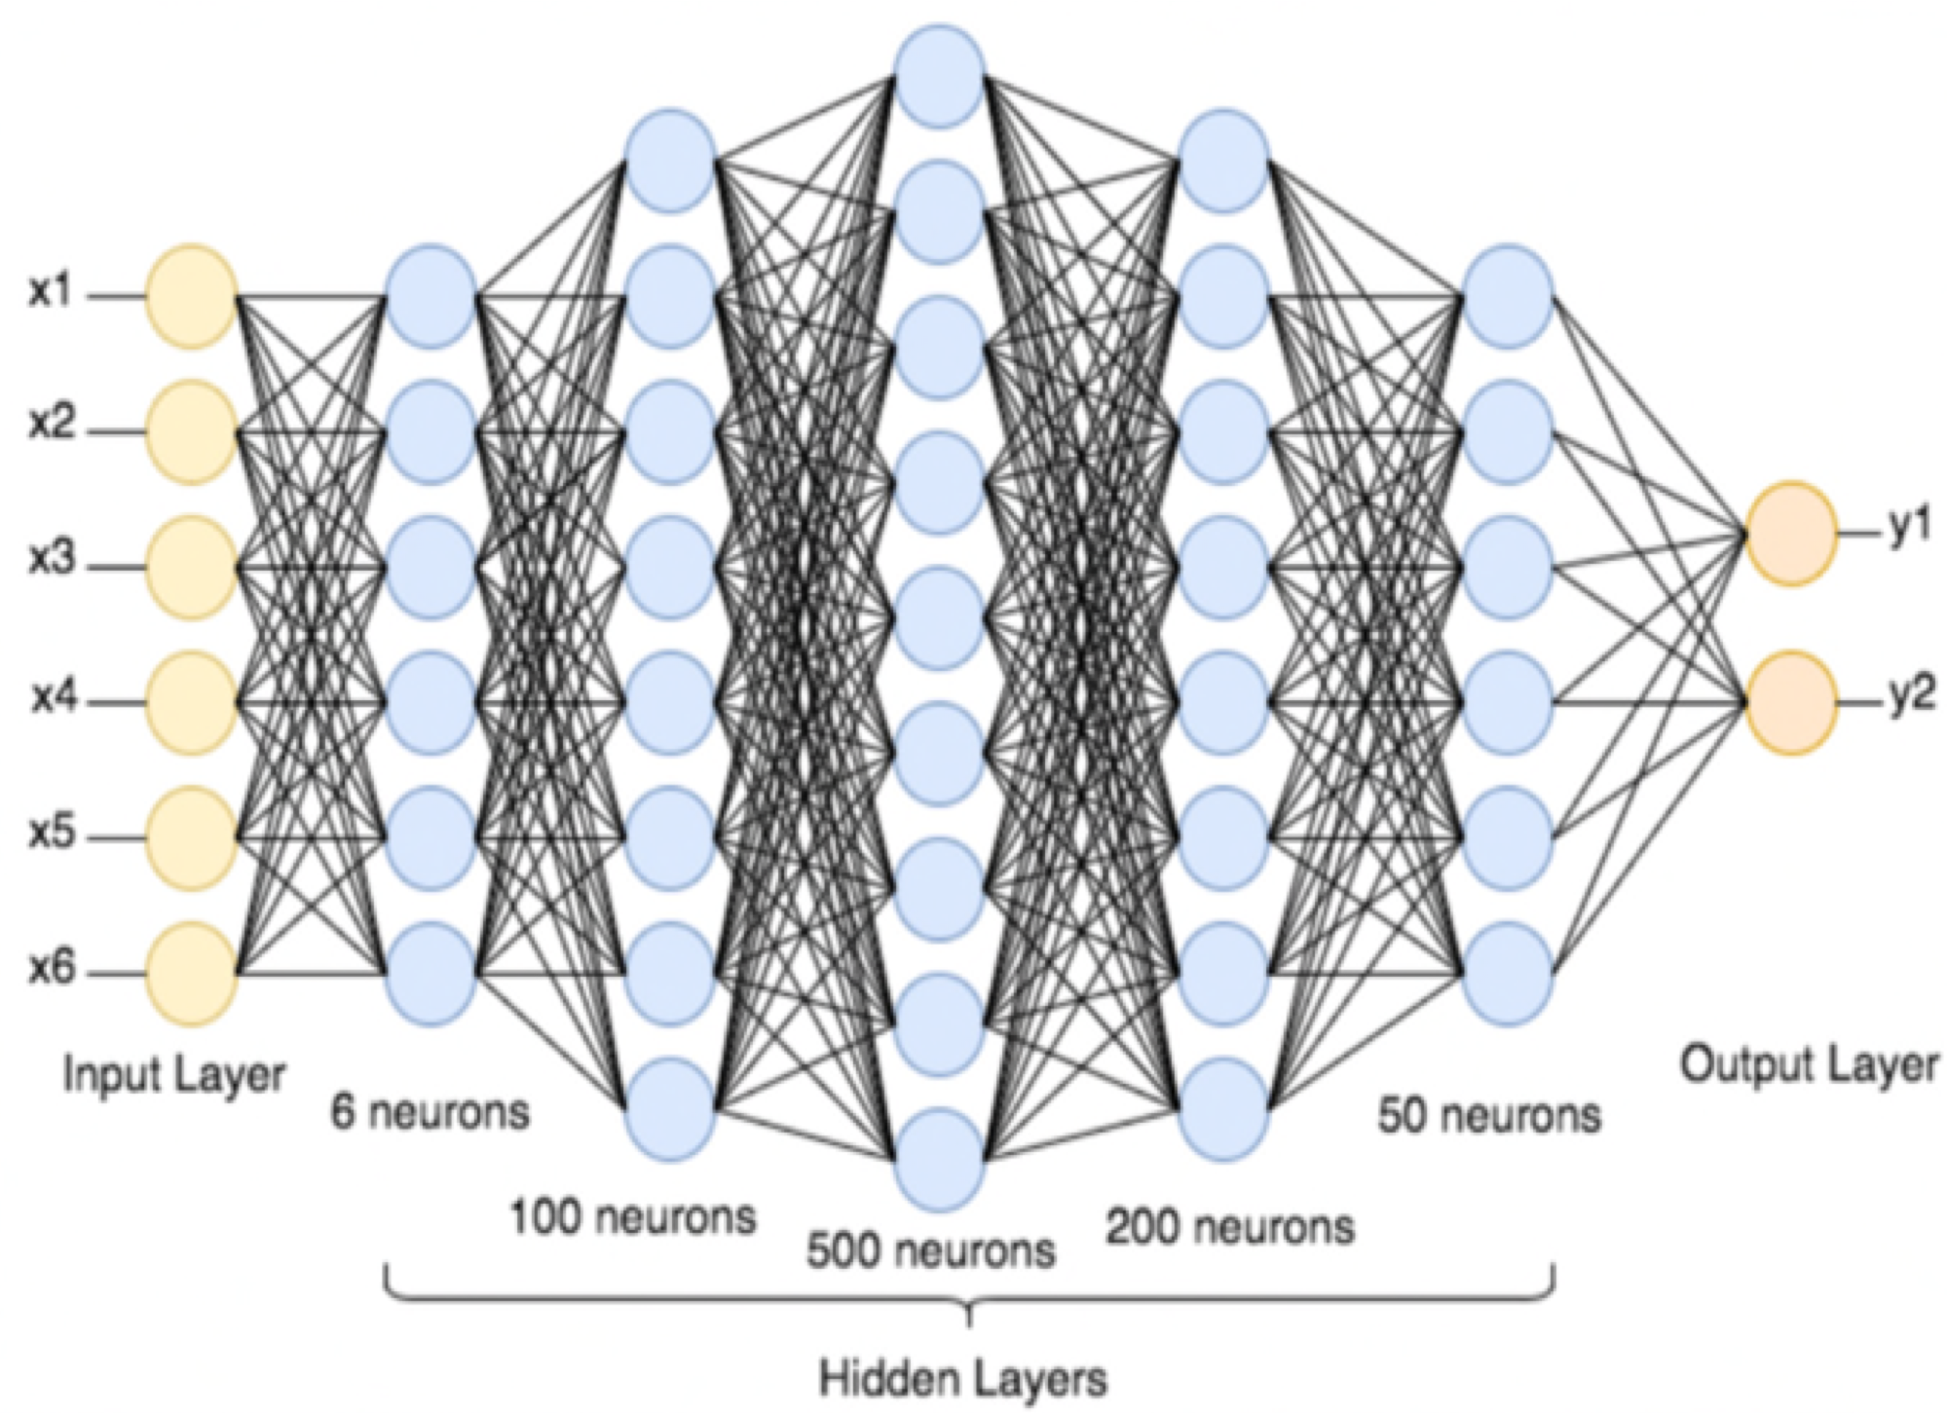
For any continuous function f defined on a bounded domain, we can find a neural
network that approximates f with an arbitrary degree of accuracy.
Notes:
For any continuous function f defined on a bounded domain, we can find a neural
network that approximates f with an arbitrary degree of accuracy.

Slide 5
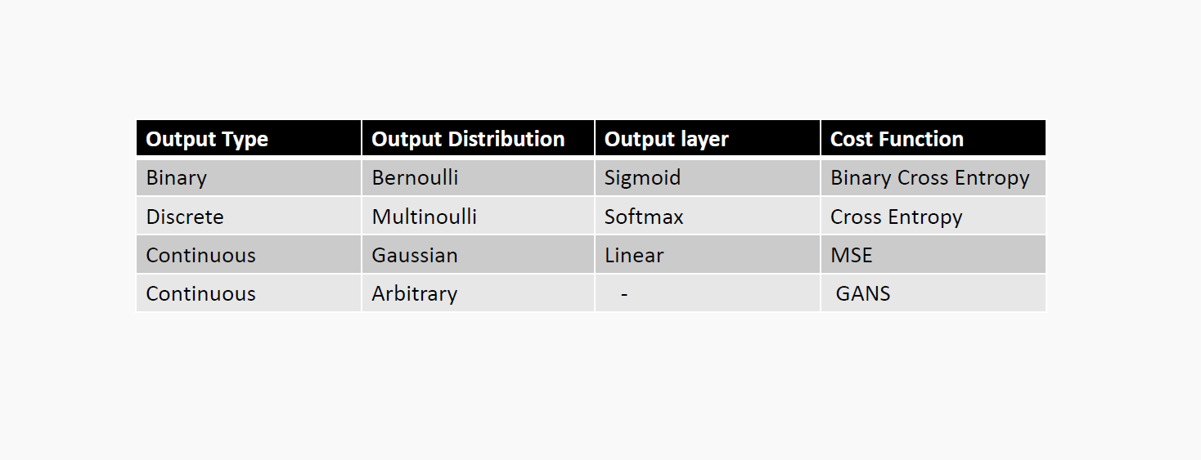
Regression vs Classification
https://playground.tensorflow.org/#activation=tanh&batchSize=10&dataset=circle&regDataset=reg-plane&learningRate=0.03&regularizationRate=0&noise=0&networkShape=4,2&seed=0.59197&showTestData=false&discretize=false&percTrainData=50&x=true&y=true&xTimesY=false&xSquared=false&ySquared=false&cosX=false&sinX=false&cosY=false&sinY=false&collectStats=false&problem=classification&initZero=false&hideText=false

Slide 6
Pre-trained Network
What is pre-trained Network?
a pre-trained model is a model created by someone else to solve a similar problem. Instead of building a model from scratch to solve a similar problem, you use the model trained on other problem as a starting point.
Conclusion: Import other’s trained weights and biases
Notes:
What is pre-trained Network?
a pre-trained model is a model created by someone else to solve a similar problem. Instead of building a model from scratch to solve a similar problem, you use the model trained on other problem as a starting point.
Conclusion: Import other’s trained weights and biases

Slide 7
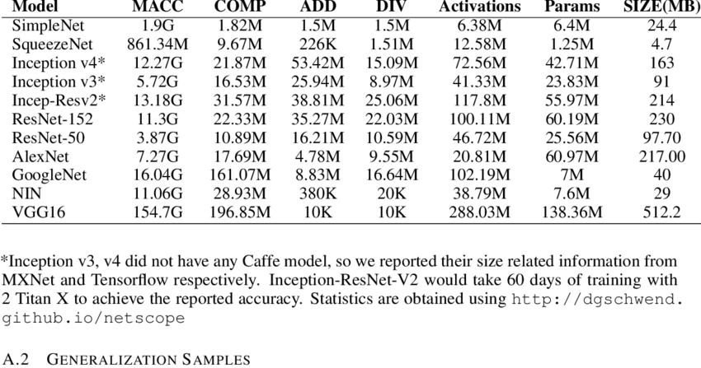
Why do we use Pre-trained Network?
engineering implementation
The cost of training time and computing power
Notes:
The main reason is we use pre-trained network. First it is so conviennce in engineering implementation. The engineering doesn’t need to go deep and have comprehensive back knowledge to use pre-trained network to implement engineering problem. Next, training a accuracy model is time-cosuming and costly. That need great computer power (expensive gpu) and spends plenty of time to train the model. Pre-trained network doens’t have this issue. In transfer learning, we can just import pre-trained model and modified the full connection and output layer. Then pay relatively less time to retrain our new model.

Slide 8
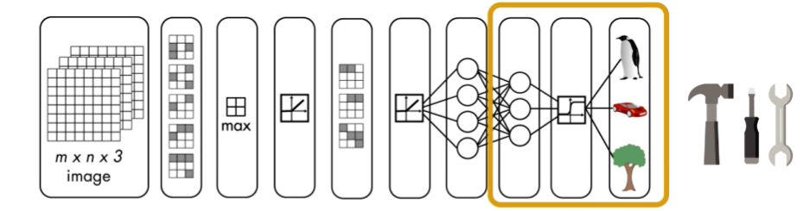

How to use pre-trained Network
Transfer learning
engineering implementation

Slide 9

CNN
Convolutional networks(LeCun, 1989), also known as convolutional neural networks, or CNNs, are a specialized kind of neural network for processing data that has a known grid-like topology (Goodfellow, Bengio & Courville, 2016)
The network employs a mathematical operation called convolution.
Notes:
Convolutional networks(LeCun, 1989), also known as convolutional neural networks, or CNNs, are a specialized kind of neural network for processing data that has a known grid-like topology (Goodfellow, Bengio & Courville, 2016)
The network employs a mathematical operation called convolution.

Slide 10
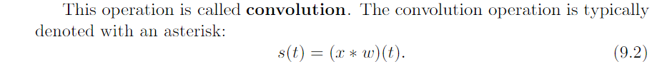
Convolution
In mathematics (in particular, functional analysis) convolution is a mathematical operation on two functions (x and w) that produces a third function (s) expressing how the shape of one is modified by the other.
In convolutional network terminology, the ﬁrst argument (in this example, the function x) to the convolution is often referred to as the input, and the second argument (in this example, the function w) as the kernel. The output is sometimes referred to as the feature map.
Notes:
In mathematics (in particular, functional analysis) convolution is a mathematical operation on two functions (x and w) that produces a third function (s) expressing how the shape of one is modified by the other.
In convolutional network terminology, the ﬁrst argument (in this example, the function x) to the convolution is often referred to as the input, and the second argument (in this example, the function w) as the kernel. The output is sometimes referred to as the feature map.

Slide 11
Difference
Input image
Convolution layer
Pooling layer
Full connected layer
Notes:
The differene between cnn and nn are the diffent types of input, speicial extra layer such as convolution layer, pooling layer, and full connect layer.

Slide 12

Input Image
The role of the CNN is to reduce the images into a form which is easier to process, without losing features which are critical for getting a good prediction
A CNN is able to successfully capture the Spatial and Temporal dependencies
Notes:
The role of the CNN is to reduce the images into a form which is easier to process, without losing features which are critical for getting a good prediction
A CNN is able to successfully capture the Spatial and Temporal dependencies

Slide 13

Convolution Layer
We are learning the bias and kernel each Convolution layer.
Input: n X n
Filter(kernal) size: f X f
Output: (n-f+1) X (n-f+1)
Notes:
The objective of the Convolution Operation is to extract the high-level features such as edges, from the input image. ConvNets don’t have to be limited to only one Convolutional Layer. Conventionally, the first ConvLayer is responsible for capturing the Low-Level features such as edges, color, gradient orientation, etc. With added layers, the architecture adapts to the High-Level features as well, giving us a network which has the wholesome understanding of images in the dataset, similar to how we would.
image Dimensions = 5 (Height) x 5 (Breadth) x 1 (Number of channels, eg. RGB)
In the above demonstration, the green section resembles our 5x5x1 input image, I. The element involved in carrying out the convolution operation in the first part of a Convolutional Layer is called the Kernel/Filter, K, represented in the color yellow. We have selected K as a 3x3x1 matrix.

Slide 14
Padding
Issue
Every time we apply a convolutional operation, the size of the image shrinks
Pixels present in the corner of the image are used only a few number of times during convolution as compared to the central pixels. Hence, we do not focus too much on the corners since that can lead to information loss
Solution
To overcome these issues, we can pad the image with an additional border, i.e., we add one pixel all around the edges.
Notes:
Issue
Every time we apply a convolutional operation, the size of the image shrinks
Pixels present in the corner of the image are used only a few number of times during convolution as compared to the central pixels. Hence, we do not focus too much on the corners since that can lead to information loss
Solution
To overcome these issues, we can pad the image with an additional border, i.e., we add one pixel all around the edges.

Slide 15

Input: n X n
Padding: p
Filter size: f X f
Output: (n+2p-f+1) X (n+2p-f+1)
Same padding:
Here, we apply padding so that the output size is the same as the input size, i.e.,
n+2p-f+1 = n
So, p = (f-1)/2
General solution:
Input: n X n
Padding: p
Stride: s
Filter size: f X f
Output: [(n+2p-f)/s+1] X [(n+2p-f)/s+1]
Notes:
For here, I’m showing the process of how convolution layer works. In the gif, we can see instead one channel image our input now become three channel in RGB foramt. Each matrix is multipied with kernal and sum together plus bias and output specidic correpensding value in the matrix at the right down corner.

Slide 16
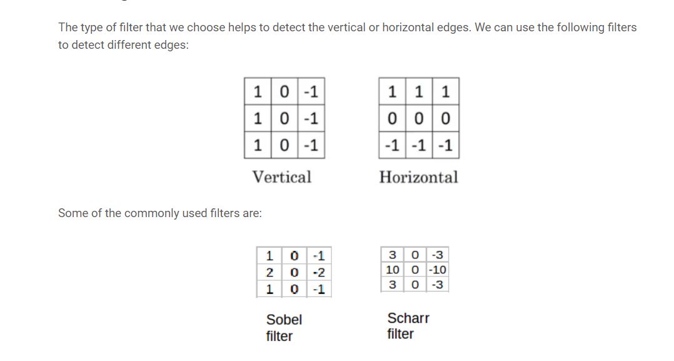
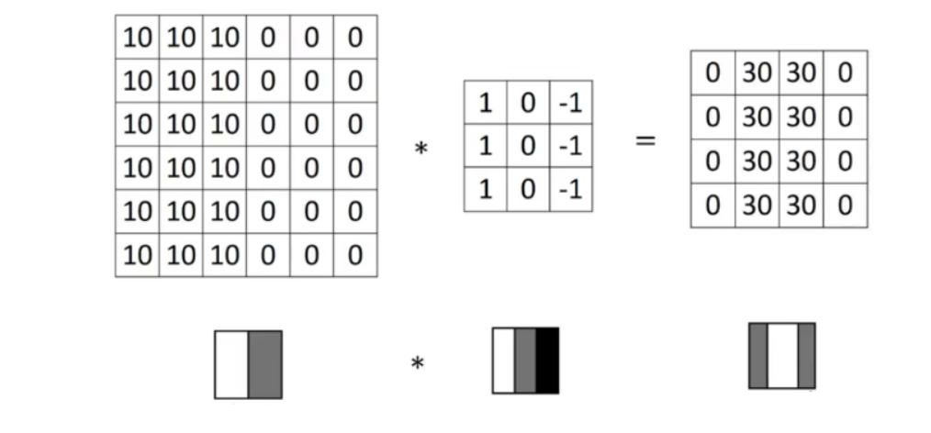
Kernel/Filter
Notes:
The type of filter that we choose helps to detect the vertical or horizontal edges. We can use the following filters to detect different edges: Instead of using these filters, we can create our own as well and treat them as a parameter which the model will learn using backpropagation.

Slide 17

Pooling Layer
Reducing the spatial size of the Convolved Feature
Max vs Average
Notes:
Similar to the Convolutional Layer, the Pooling layer is responsible for reducing the spatial size of the Convolved Feature. This is to decrease the computational power required to process the data through dimensionality reduction. Furthermore, it is useful for extracting dominant features which are rotational and positional invariant, thus maintaining the process of effectively training of the model.

Slide 18
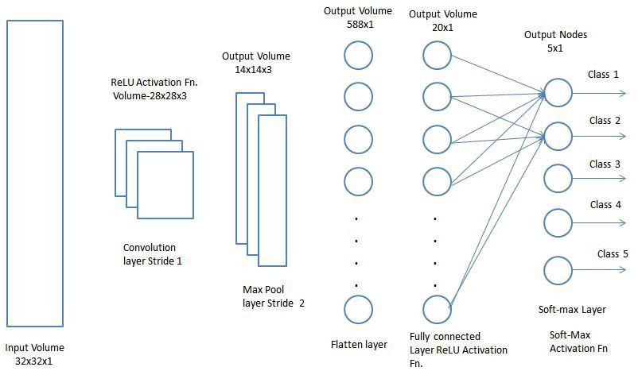
Classification — Fully Connected Layer (FC Layer)
Adding a Fully-Connected layer is a (usually) cheap way of learning non-linear combinations of the high-level features as represented by the output of the convolutional layer.
Notes:
Adding a Fully-Connected layer is a (usually) cheap way of learning non-linear combinations of the high-level features as represented by the output of the convolutional layer.

Slide 19
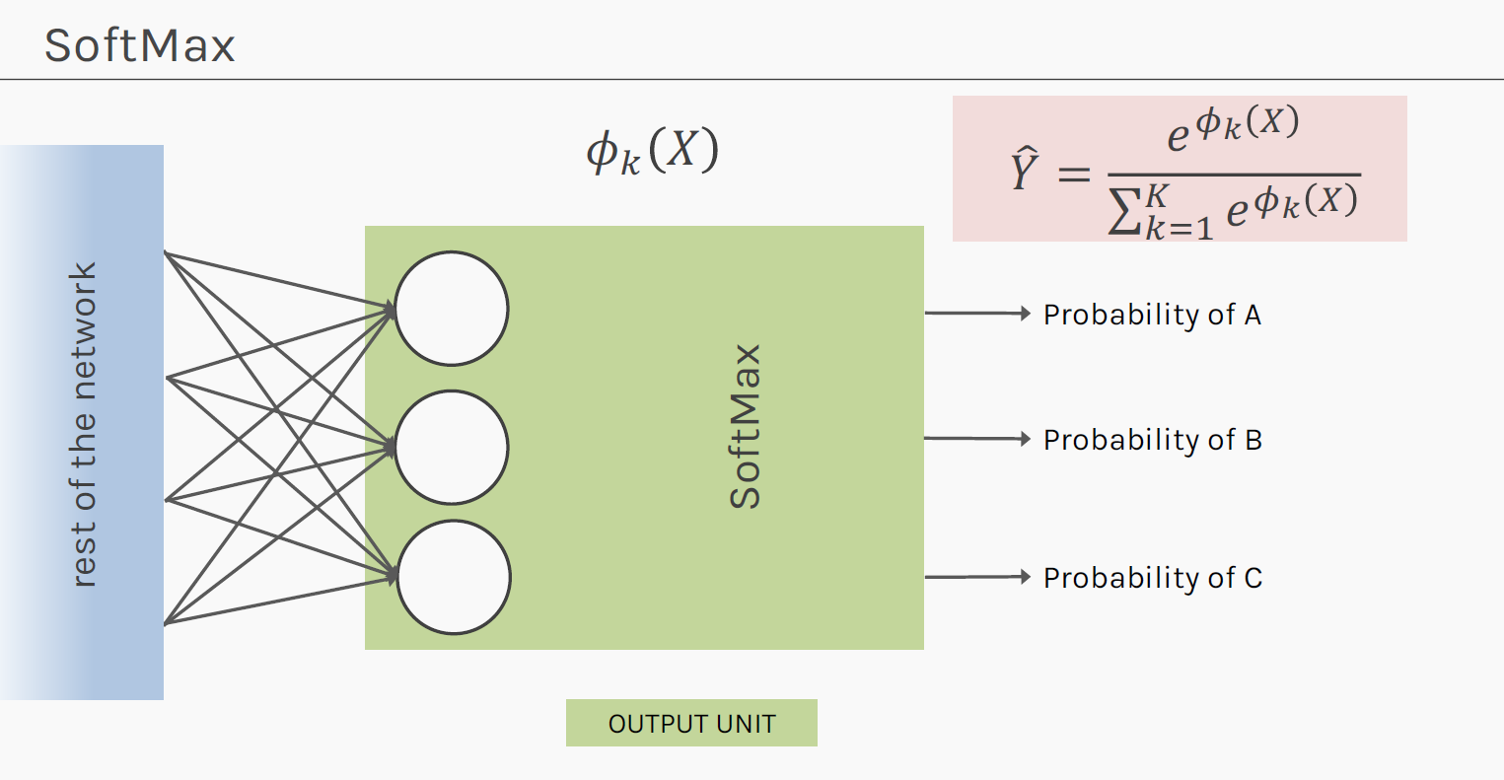
Output
Softmax

Slide 20
Examples
LeNet
AlexNet
VGGNet
GoogLeNet
ResNet

Slide 21
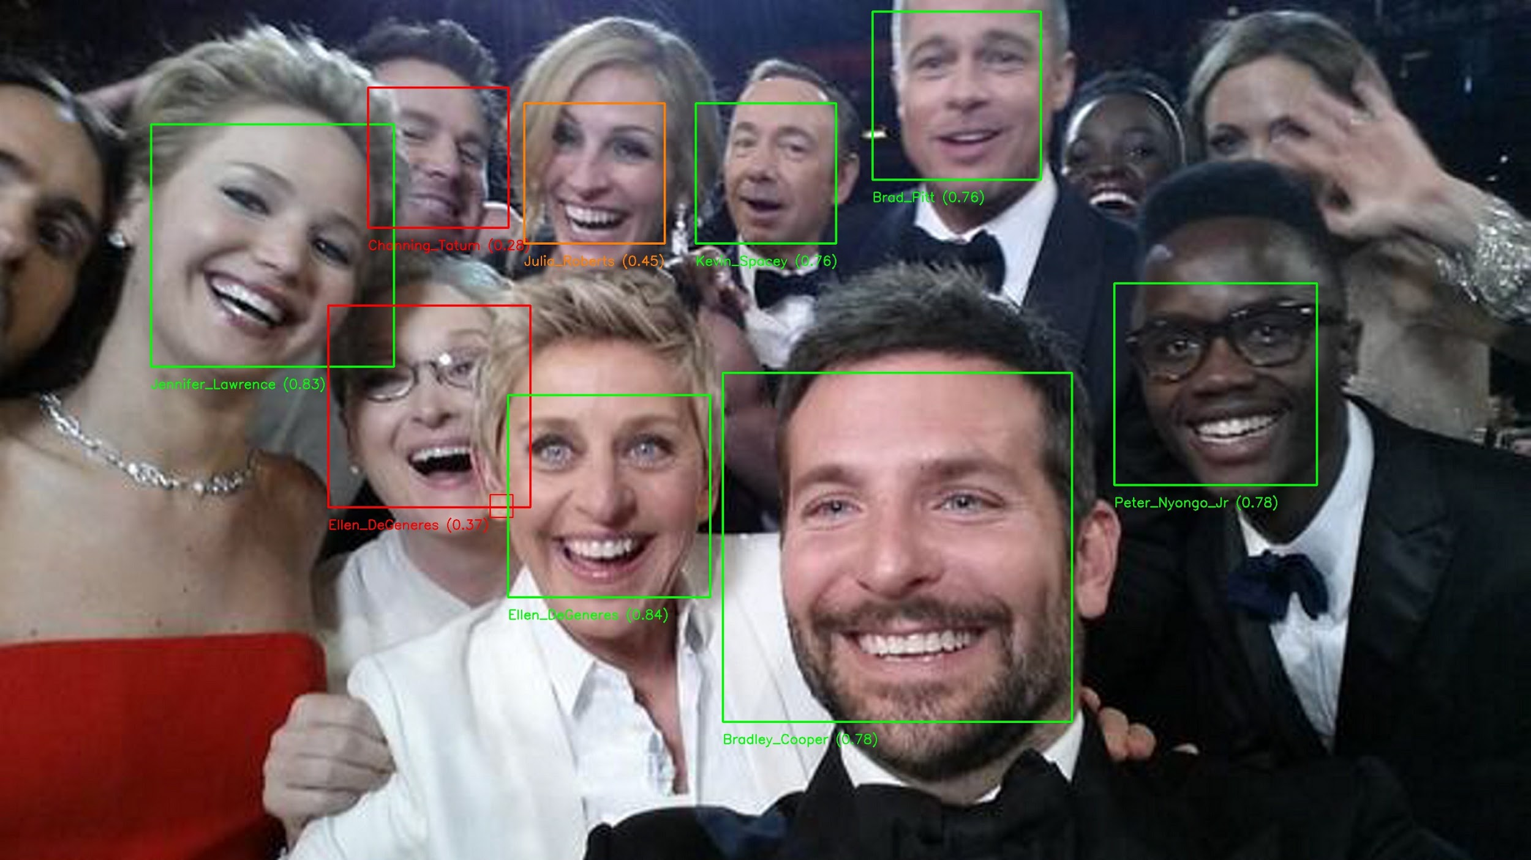
Application
Face recognition
In face recognition literature, there are majorly two terminologies which are discussed the most:
Face verification
Face recognition
In face verification, we pass the image and its corresponding name or ID as the input. For a new image, we want our model to verify whether the image is that of the claimed person. This is also called one-to-one mapping where we just want to know if the image is of the same person.

Slide 22
Object Detection
To understand the challenges of Object Localization, Object Detection and Landmark Finding
Understanding and implementing non-max suppression
Understanding and implementing intersection over union
To understand how we label a dataset for an object detection application
To learn the vocabulary used in object detection (landmark, anchor, bounding box, grid, etc.)

Slide 23
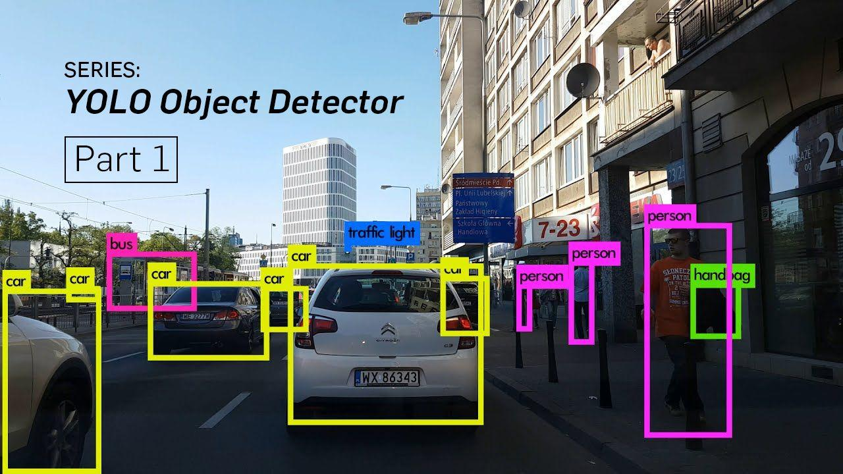

Slide 24






The essential building and their common sign in mini town

Slide 25

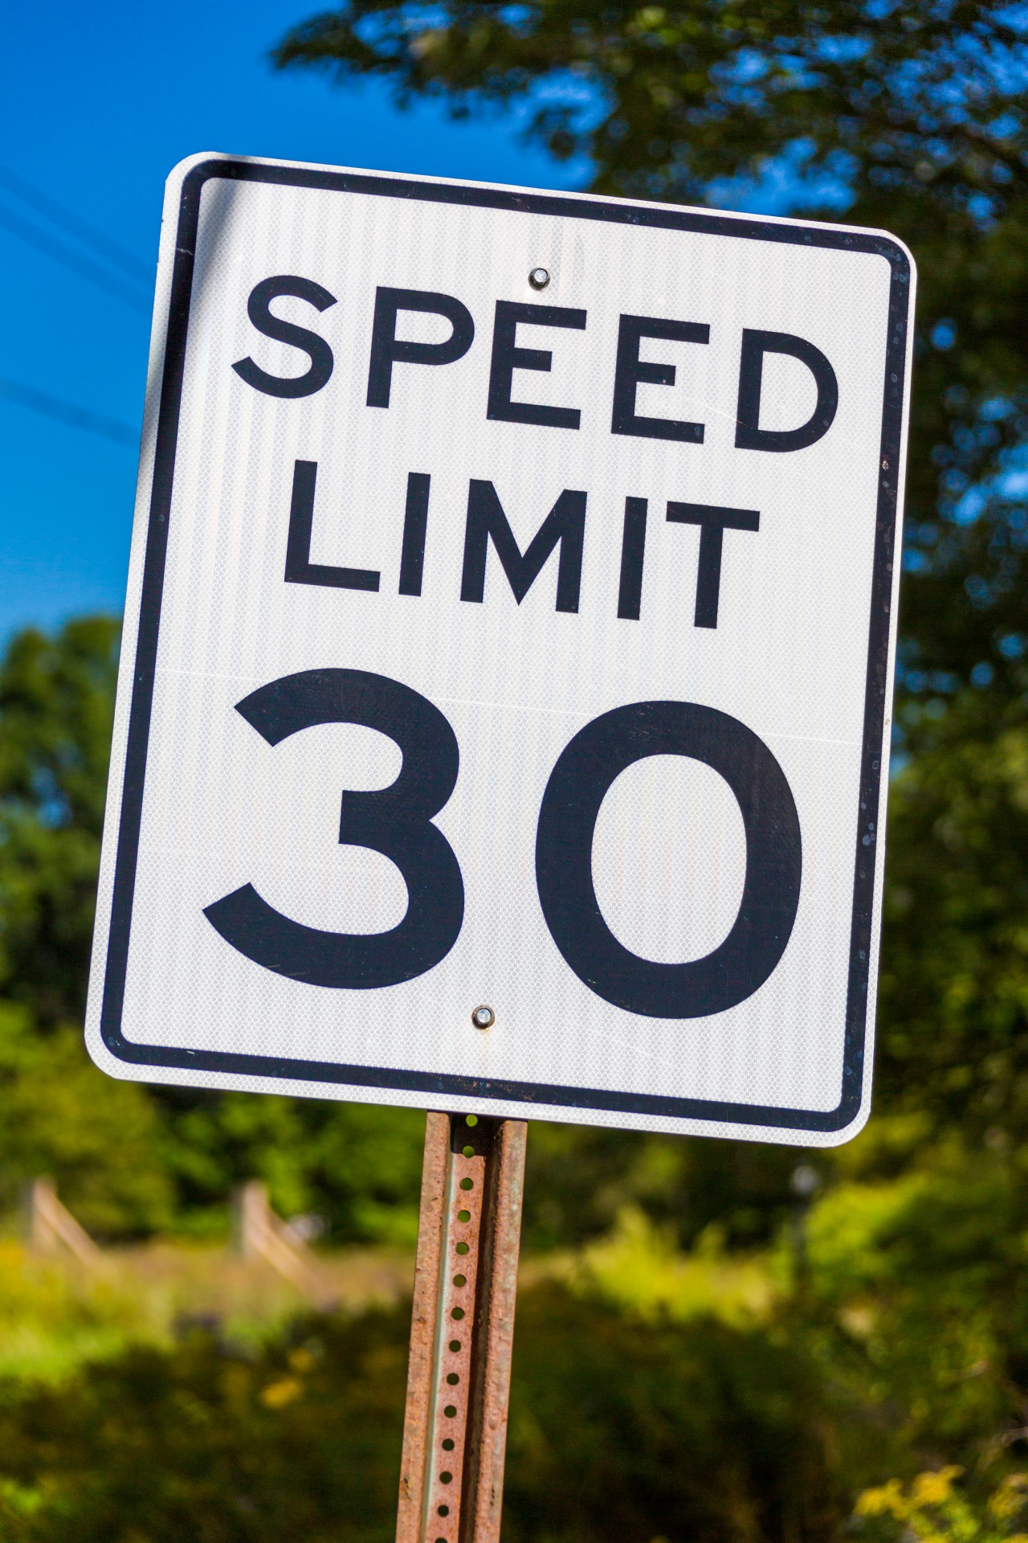
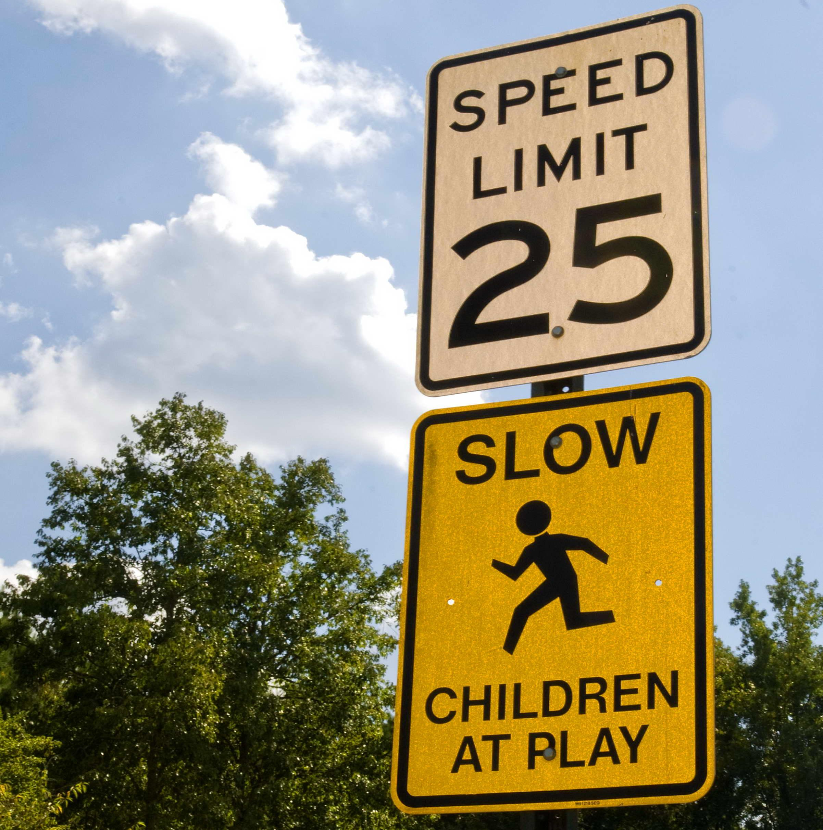


No building features

